Slide 1
Building a High-Profile Survey Solution with Talend
Name: Vhuyo Sitsula

Slide 2
Business Problem
The Business is doing a high profile survey to find a suitable area to safe guard the Board of Directors in an event of a global war break out. Some geographical information is required. The Business needs to know the following:
1. How many airports, airfields and heliports exist in each country and continent? 2. What is the average elevation of the airports, airfields and heliports in each country? 3. What is the estimated population of each country? 4. How many cities/towns/settlements in each country? 5. What is the min, max and average elevation of the cities per country? 6. Which are the highest and lowest elevated cities in the world with populations > 100000? 7. Which are the highest and lowest elevated airports, airfields and heliports on the planet?

Slide 3
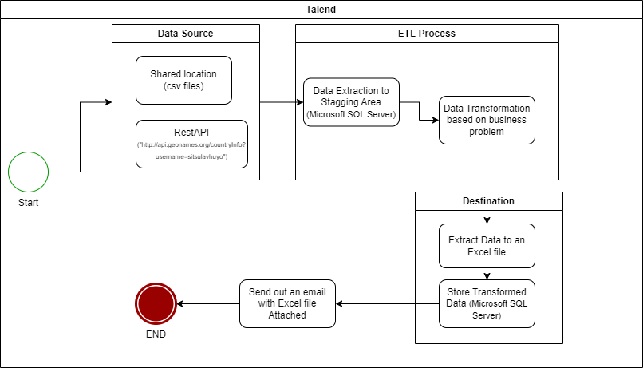
Solution
Solution Architecture

Slide 4
Solution Architecture Overview
Data Sources: - Talend components to connect to these sources and extract the necessary data - Data sources: csv files : txt files : api ("http://api.geonames.org/countryInfo?username=sitsulavhuyo")
2, Talend Data Integration Platform: -Talend serves as the core data processing engine in the architecture. -Talend offers a visual interface for designing data integration workflows and transformations.
-

Slide 5
Solution Architecture Overview Cont..
3.Data Processing Workflow:
The data processing workflow involves several stages:
Data Ingestion: Raw data is extracted from source data sources.
Data Transformation: Talend performs cleansing, enrichment, and transformation of the raw data to make it suitable for analysis and storage.
Data Quality Checks: Quality checks are implemented to ensure data integrity and consistency.
Data Aggregation and Summarization: Talend aggregates and summarizes data to generate insights.
Data Loading: Processed data is loaded into the Microsoft SQL Server database for storage and further analysis.

Slide 6
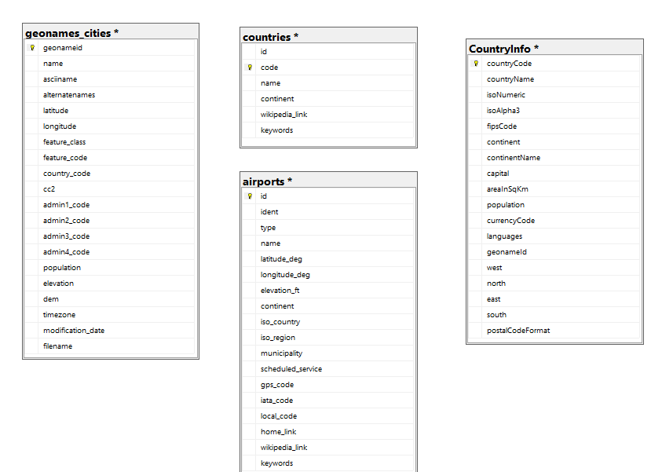
Data Model
4. RDBMS - Microsoft SQL Server: SQL Server is used as the primary data storage solution in the architecture. It provides a scalable and reliable relational database management system (RDBMS) for storing structured data.
StagingDB

Slide 7
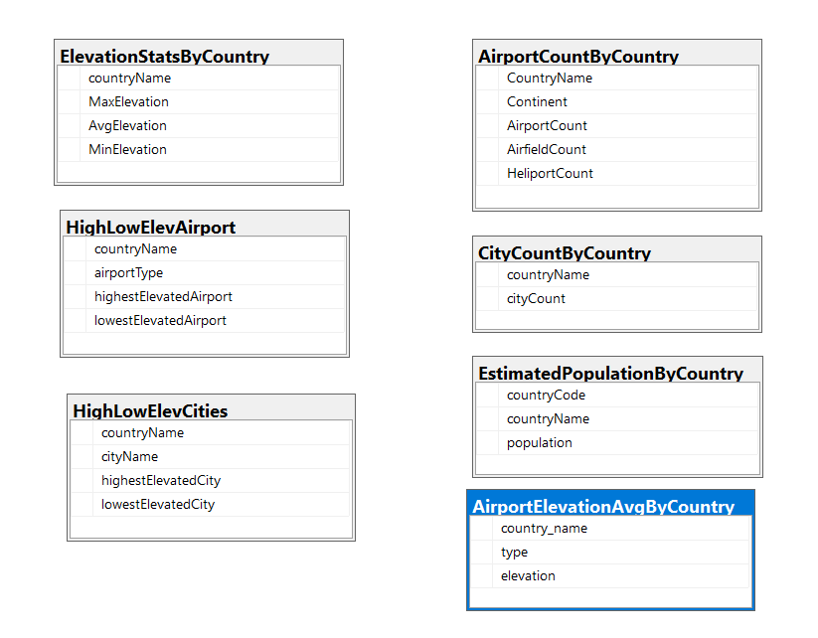
Data Model
TransformationDB

Slide 8
Data be refreshed vs Visual Representation
How often will the process run?
-The process will run daily against the refreshed data from the sources
Visual Representation
-An email will be sent out with an excel attachment.
Source Code -Source code can be found here : https://github.com/vhuyositsula/Data_Engineer_Assesment_FNB.git

Slide 9
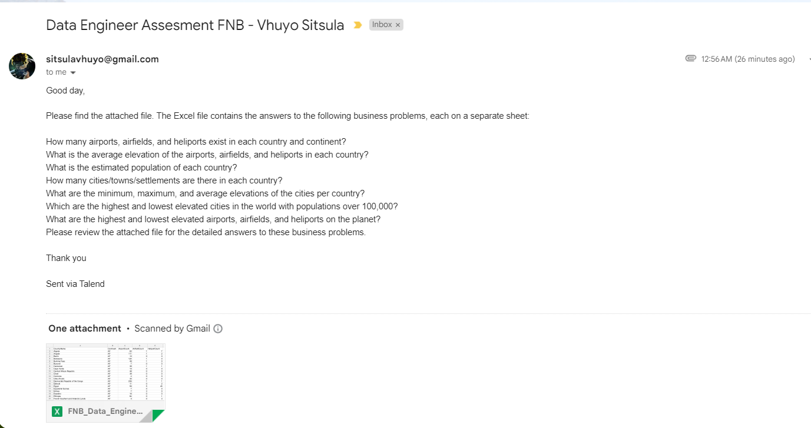
Email Notification Sample

Slide 10
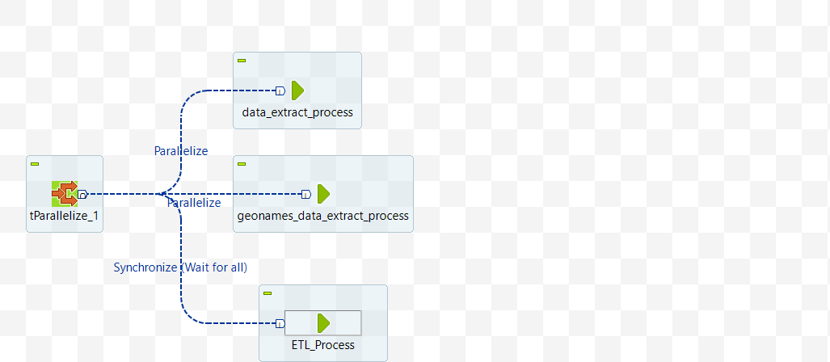
Talend Jobs
1, Main Job - high_profile_survey_process_0_1

Slide 11
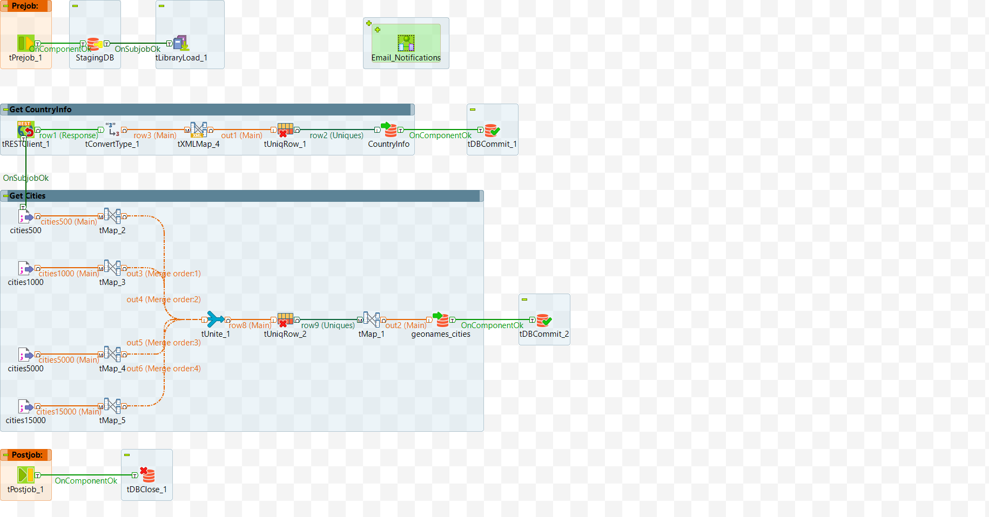
Talend Jobs
1, data_extract_process_0_1

Slide 12
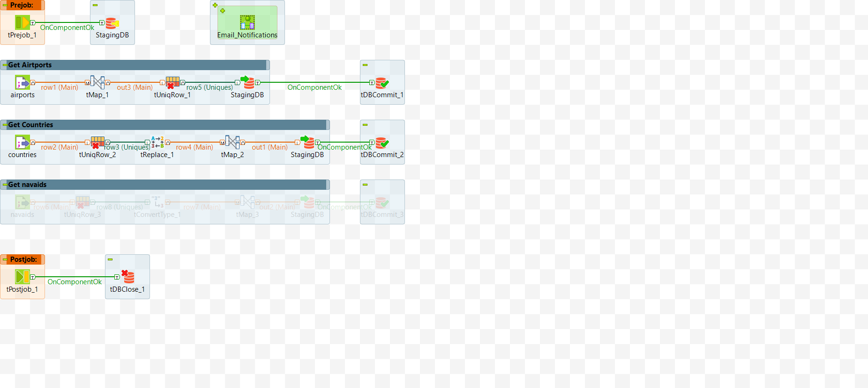
Talend Jobs
2, data_extract_process_0_1

Slide 13
Talend Jobs
3, geonames_data_extract_process_0_1

Slide 14
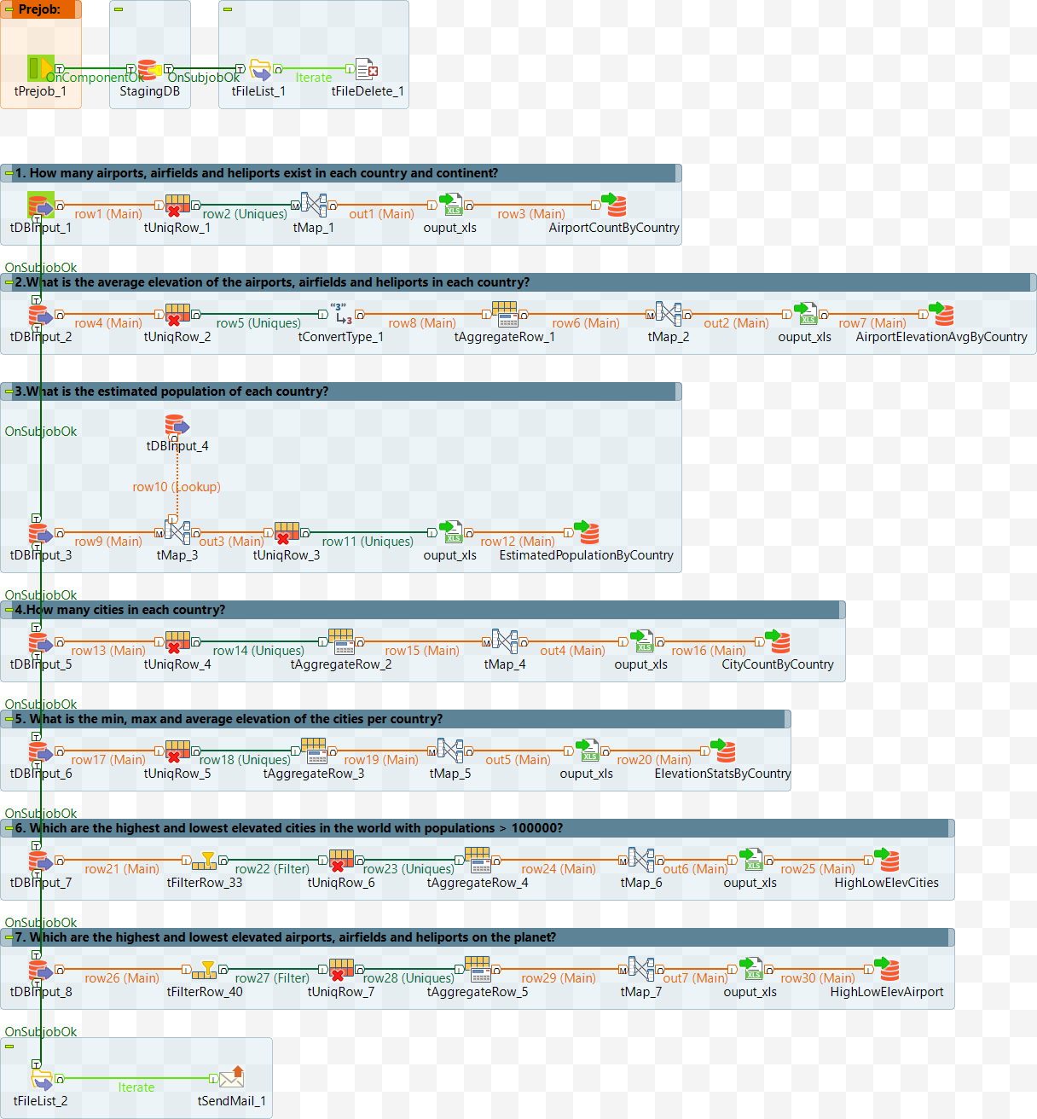
Talend Jobs
4, ETL_Process_0_1

Slide 15
THANK YOU

